Slide 1

Foursis Technical Solution
HR Training and Recruitment Outsourcing
Right Person @ Right Place @ Right Time

Slide 2
We know…
Human Resource
HR is the term used to describe the individuals who make up the workforce of an organization.
HR Outsourcing (HRO)
Human Resource Outsourcing (HRO) helps an organization to gain cost and; time efficiencies and provides cutting edge over their human resource strategies and improves service to their employees.
Benefits of Outsourcing
Reduce hiring delays - fill vacancies rapidly
Reduce recruiting administration by as much as 50% - this means more time available for other HR initiatives
Maximize your revenue and minimize your expenses.
Get access to specialized skills and services.

Slide 3
We also know…
Recruitment
Recruitment refers to the process of attracting, screening and selecting qualified people for a job.
Recruitment Stages
Sourcing candidates by advertising or other methods
Screening potential candidates by conducting tests and/or interviews
Selecting candidates based on the results of the tests and/or interviews
On boarding to ensure the candidate is able to fulfill their new role effectively

Slide 4
About FTS
Mission -
To save the time of the client by providing the resource and services, so that they could concentrate on their core business.
Service –
Recruitment & Selection
Permanent and Contract Employment
Training & Development
Management Consulting
We Recruit in -
Manufacturing, IT, Academics , FMCG, Retail, Pharma, Construction…

Slide 5
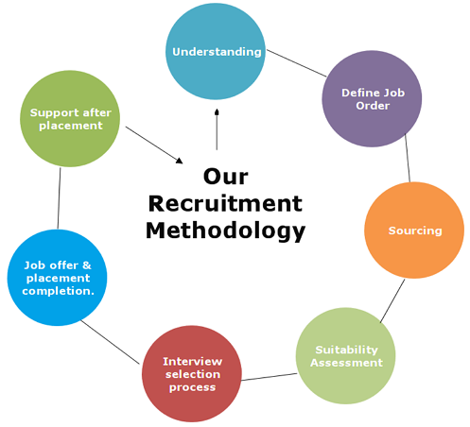
Methodology

Slide 6
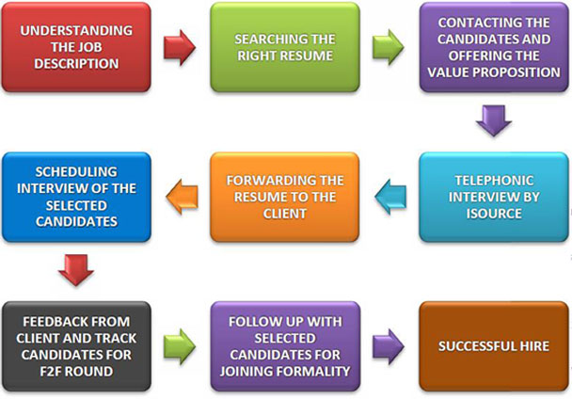
Our Recruiting Process

Slide 7

E-Recruitment Process
Identify current needs of employment in the organization
Posting the advertisement of the job vacancy on job board (on line)
Managing the response i.e., Applicant data base
Screening of applicant according to job description
Arranging and conducting online interviews – By chatting, video conferring etc.
scrutinized candidates CV and Visume is forwarded ahead.
Decision making regarding further process

Slide 8
Visume
Select your candidate with our Visume process.
Better and faster short listing process – The applicants are asked to apply with their Curriculum Vitae and Visume (Video Resume) for the faster selection process.
Link – https://www.youtube.com/watch?v=wg5yIa6rAVk
Benefits of Visume
- Shortlisting process fasters for the exact match
- A CV applied does only shows his / her experience and level of work but a visume record shows his communication skills, personality and body language that supports to shortlist the best match required profile for the employer.
- This would bring the exact required profile for the interview.
- A visume applied would save the applicants and the employers time for the recruiting process.

Slide 9

Our Strength
As a strategic partner we offer the tips and advice for the resume / video resume and interview preparation and also prepare our candidates with the expected questions. This will benefit both company as well as candidate. The requirement is identified and potential candidate is selected.

Slide 10

Data Source
Advertisement
Inbuilt systematically designed database
Job portals
Social Media
Job posting
Referencing
Head Hunting
Campus Recruitment

Slide 11

Training & Development
Corporate Training
In house Training Programs
- Career counseling
- Making effective Resume / CV
- Making Video Resume (visume)
- Interview Etiquettes
- Personal Etiquettes

Slide 12

THANK YOU
Foursis Technical Solutions
358, Jasal Complex, Opp. Sterling Hospital, 150 Ft. Ring Rd., Rajkot, Gujarat
Website: www.foursis.com Mail id: info@foursis.com
Voice: Dushyantsingh– 9662441222
Follow us on

